Slide 1

Long KDP, Dr. Pepper over Keurig PT: ~$37, Return ~10%+ Zach MARIANI
11 September 2023

Slide 2
Thesis
Market considers KDP as a coffee company despite the majority (and increasingly so) of revenue and EBIT coming from beverages (less than 30% of EBIT from coffee by next year)
KDP beverages business is higher quality than KO and PEP, less elastic, despite trading at a lower multiple (18 vs 21.4 for KO and 22.5 for PEP)
CEO has willingness to raise prices beyond KO and PEP, volume won’t suffer
Modeling shows that even with coffee surprising to the downside, given revenue/EBIT split between the businesses -> beverage price expansion will led to EBIT margin expansion -> EPS surprising to the upside
PT based on FY’23 EPS of $1.83 (vs $1.70 consensus), with 20x P/E multiple (currently ~18.1x)

Slide 3
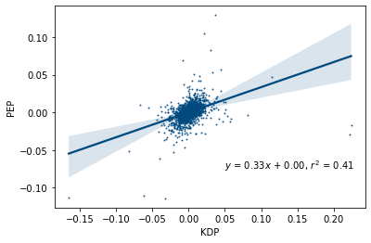
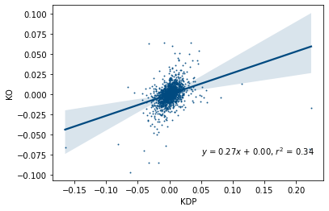
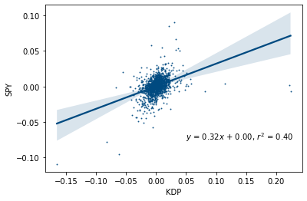
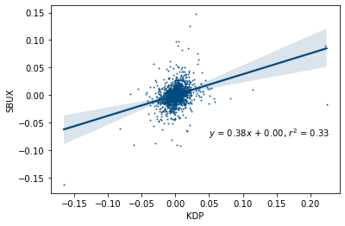
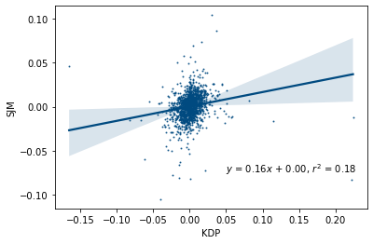
The Market Believes that KDP is a Coffee Company
Comparing Daily Returns between KDP and Peers
PEP
KO
Pepsi, beta is 0.33, r2 is 0.41
Coca-Cola, beta is 0.27, r2 is 0.34
SBUX
SJM
Global coffee shop chain, beta is 0.38, r2 is 0.33
Large, ground coffee producer, beta is 0.16, r2 is 0.18
Market Typically Perceives KDP as a Coffee Company over Beverage Company. Daily returns since Jan 1, 2018 are more closely aligned with SBUX than PEP & KO.

Slide 4
KDP is Increasingly a Beverage Company
% of EBIT and Revenue from Beverages

Slide 5
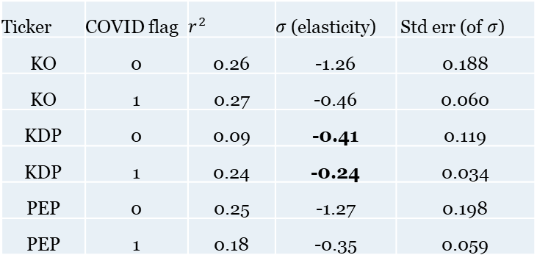
Demand for KDP’s Beverages is Highly Inelastic
Ticker | COVID flag | $$r^{2}$$ | 𝜎 (elasticity) | Std err (of 𝜎)
KO | 0 | 0.26 | -1.26 | 0.188
KO | 1 | 0.27 | -0.46 | 0.060
KDP | 0 | 0.09 | -0.41 | 0.119
KDP | 1 | 0.24 | -0.24 | 0.034
PEP | 0 | 0.25 | -1.27 | 0.198
PEP | 1 | 0.18 | -0.35 | 0.059

Slide 6
Despite Extremely Inelastic Demand Historically, Pricing Typically Lower than PEP and KO

Slide 7
Plenty of Room…

Slide 8
…& Willingness to Run with Limited Volume Impact
“Interestingly, carbonated soft drinks has been the area we’re seeing …the least amount of elasticity. One of my hypotheses is because it was too good of a value at the start… It was underpriced. And so, when you are able to take that amount of pricing and have absolutely no impact on the consumer, it tells you that we were giving too much of the product away historically.”
– Bob Gamgort, KDP CEO, Barclay’s Global Consumer Staples Conference, September 6, 2023
“So private label switching is principally a feature firstly in Europe and then to some extent also in the US… in our view, [it’s] highly related to the strength of the brands in any specific category. So we see it more in terms of beverages happening in water and juices rather than soft drinks, and certainly less when you get to Colas”
– James Quincey, KO CEO, Q2 FY 2023 Earnings Call, July 26, 2023

Slide 9

Price and Volume Matter
VA has KDP beverage volume growth at -0.2%, price at 5.4% for Q3FY23, vs 0.6% and 4.8% for KO and -2.9% and 9.1% for PEP.
VA has KDP beverage volume growth at 0.3%, price at 8.2% for FY23 vs -0.1 and 7.1% for PEP and -2.9% and 10.3% for KO .
This is despite KDP’s CEO being openly willing to raise prices in a way which KO and PEP’s CEOs are not.
KDP has expressed high willingness to raise price -> limited volume decrease with highly inelastic product -> great EBIT margin expansion / flow through
Market ignores this on earnings calls in favor of coffee, more exciting to model, stickier business, more differentiated… but largely a distraction

Slide 10
Coffee Gets Too Much Airtime
Doubt about 2M+ HHs annually
Analysts have been doubting KDP’s ability to add 2MM HH annually, having the same conversations since 2013 despite KDP continuing to be able to add for ~10yrs
Sticky / interesting business model
Attach rate coming under fire post COVID, pricing on pods falling, concerns about brewer shipments and mobility
Really doesn’t matter
Coffee revenue growth is less exciting than beverages and has worsening EBIT margins. Given the shrinking share of EBIT, analysts should care less and focus more on beverages which will drive EPS.

Slide 11
Event Path
Remainder of Q2 FY’23
Q3 FY’23 Earnings Call
Q4 FY’23 Earnings Call
Look for continued pricing strength in beverage products. Attach rate for coffee to lower. Stock to trade more closely in line with SBUX than KO and PEP.
Price for beverages to smash expectations. EBIT margin expansion on pricing -> higher EPS -> stock swing to the upside. Analysts to spend most of the time on call discussing coffee. Attach rate, time spent at home will get too much air time. CEO/CFO to shift focus to innovation in coffee and/or beverage growth.
Weaker coffee holiday season with pulled forward demand. HH expansion to hit the 2MM YoY growth number as reported. Beverage pricing will continue with limited volume impact. Top line beverages and beverage EBIT to surprise to the upside. Beyond FY’23, potential for coffee downside to re-overwhelm EPS.
CONFIDENTIAL

Slide 12
Variance Table
 | Variance Table
Metric | Q3FY23 | Q4FY23 | FY23 | FY24
Revenue Growth
MARIANI | 4.8% | 3.0% | 5.7% | 2.1%
Street | 3.5% | 4.3% | 5.6% | 4.7%
Difference (bps) | 135 | (126) | 12 | (261)
Bevs Growth
MARIANI | 9.0% | 7.0% | 10.1% | 3.8%
Street | 5.5% | 5.1% | 8.6% | 4.6%
Difference (bps) | 350 | 194 | 151 | (86)
Coffee Growth
MARIANI | -5.2% | -5.4% | -4.5% | -3.4%
Street | -1.3% | 1.5% | -1.5% | 3.4%
Difference (bps) | (383) | (689) | (298) | (674)
EBIT Margin
MARIANI | 27.1% | 28.2% | 24.9% | 24.6%
Street | 25.8% | 28.1% | 24.7% | 25.3%
Difference (bps) | 125 | 10 | 25 | (72)
Adj Diluted EPS
MARIANI | $0.51 | $0.55 | $1.83 | $1.84
Street | $0.46 | $0.54 | $1.70 | $1.86
Difference (%) | 12.0% | 2.3% | 7.8% | -1.3%

Slide 13
Key Risks
Relies on continued pricing growth in beverage
*Coffee at risk of overwhelming the narrative*
KDP has historically lagged KO and PEP pricing
KDP may view themselves as a value proposition in which case they will be hesitant to raise prices faster than KO and PEP, who are willing to slow given their weaker pricing power (different reality vs. Barclay’s conference outward perception)
Analysts have always spent the vast majority of the calls discussing coffee
Coffee has everything investors like, a large, sticky recurring revenue base, an easy to understand business model, and an interesting business to model
Losses in coffee may shift P/E multiple even lower
Global economic headwinds
Changing consumer preferences
Consumers may be less willing to buy soda if the economic environment worsens
Soda can be perceived as a discretionary treat that is turned away from if labor market/other macro conditions worsen
This notably didn’t happen during COVID, but consumer may shift
Preferences have been changing over the longer term horizon towards healthier foods
KDP may not be able to continue innovation in line with what consumers want, diet sodas, sparkling waters, etc.
They have been able to in the past with Polar and Diet brands
Key risk *coffee at risk of overwhelming the narrative*, mitigants italicized when identified.

Slide 15
Appendix

Slide 16
Comps Table

Slide 17
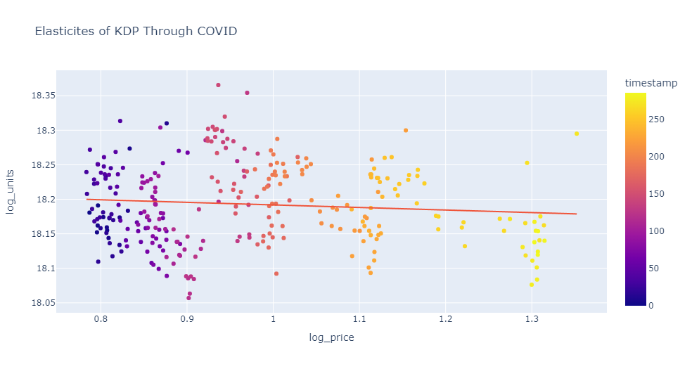

Slide 18
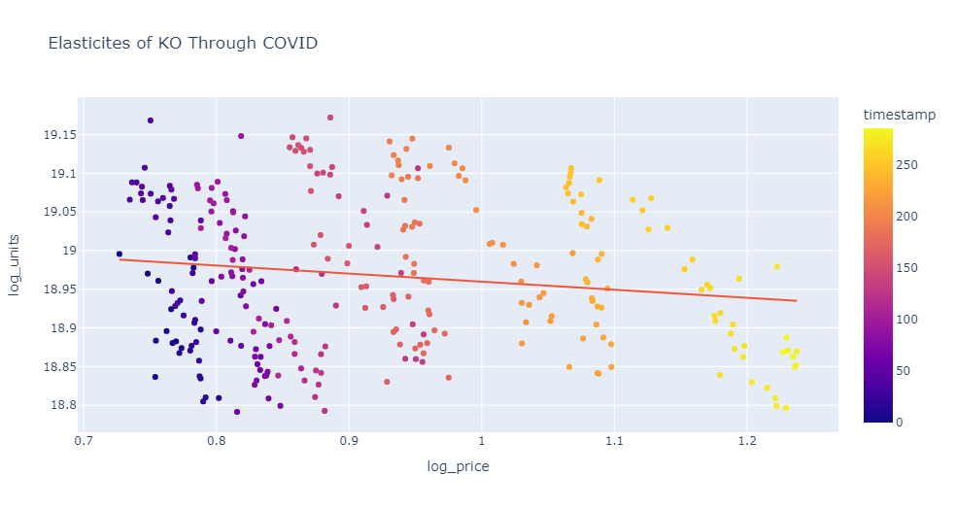

Slide 19
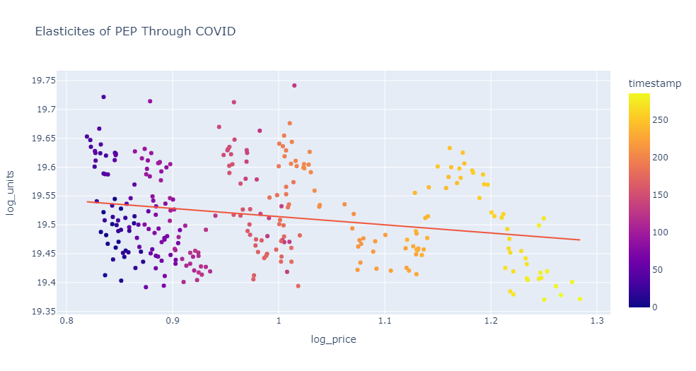

Slide 20
Coffee Trends

Slide 21
Coffee Trends

